Slide 1
BITS Pilani presentation
K. Venkata Ratnam
Mathematics

Slide 2
Course Number : SS ZC416
Course Title: MATHEMATICAL FOUNDATIONS
FOR DATA SCIENCE
Lecture No. :6

Slide 3
Todays Lecture
Eigen Values and Eigen Vectors

Slide 4
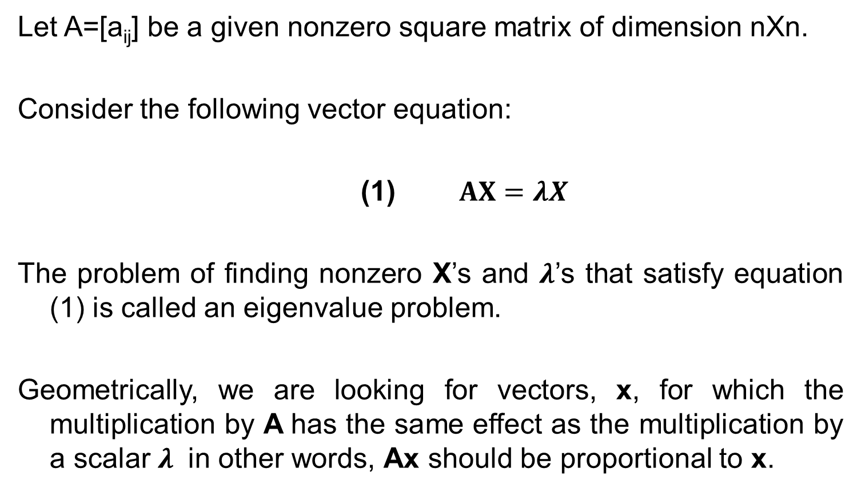
Eigen value
Let A=[a_{ij}] be a given nonzero square matrix of dimension nXn.
Consider the following vector equation:
(1) $AX=λX$
The problem of finding nonzero X’s and $λ$’s that satisfy equation (1) is called an eigenvalue problem.
Geometrically, we are looking for vectors, x, for which the multiplication by A has the same effect as the multiplication by a scalar $λ$ in other words, Ax should be proportional to x.

Slide 5
Applications
Stretching of an elastic Membrane: Finding principal directions : Eigen vectors
Markov Process: Limit state of the process in which these state vector X is reproduced under the multiplication by the stochastic matrix A governing the process.: Eigen vector equation.
Population Model : Leslie : Age specified population growth.
Vibrating system of two masses on Two strings : A system of differential equations: fundamental matrix : Eigen values

Slide 6
Applications
Eigenvalues have a very large number of applications in diverse fields such as in engineering, geometry, physics, mathematics, biology, environmental science, economics, psychology, and other areas. You will encounter applications for elastic membranes, Markov processes, population models.
Eigenvectors make understanding linear transformations easy. They are the "axes" (directions) along which a linear transformation acts simply by "stretching/compressing" and/or "flipping"; eigenvalues give you the factors by which this compression occurs.
Stability analysis, vibration analysis, atomic orbitals, facial recognition, and matrix diagonalization.

Slide 7
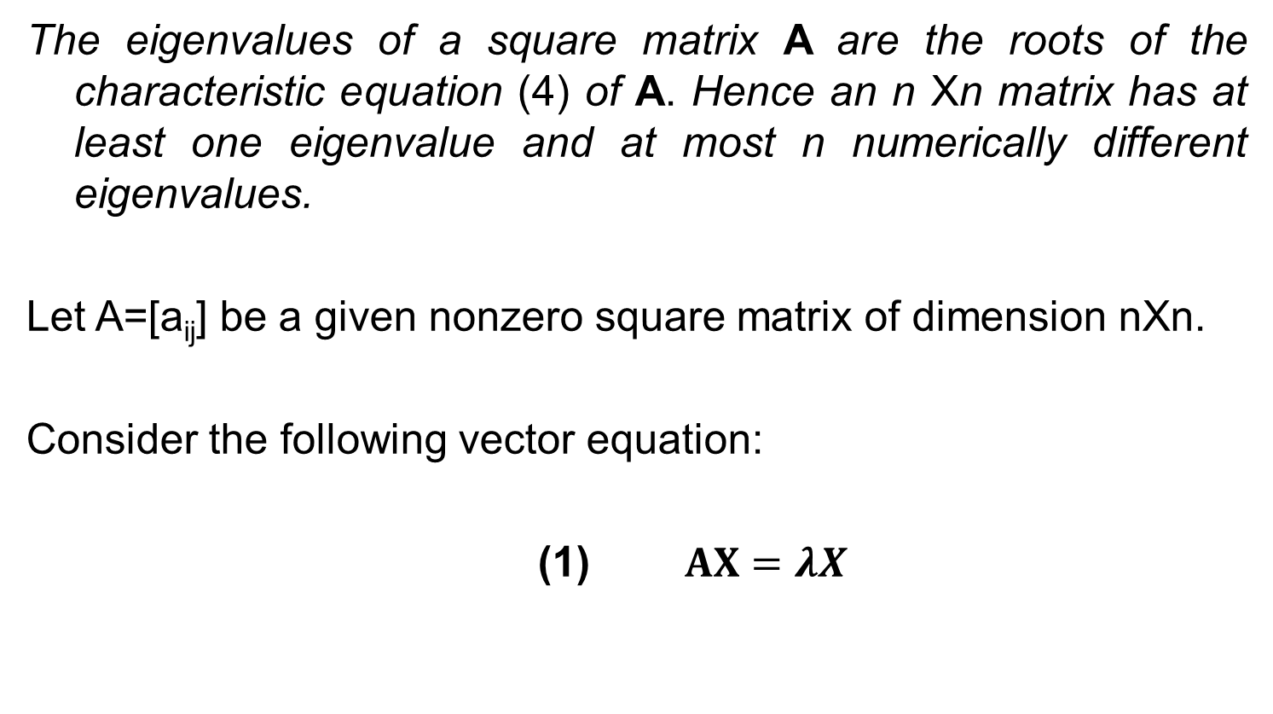
Finding Eigenvalues
The eigenvalues of a square matrix A are the roots of the characteristic equation (4) of A. Hence an n Xn matrix has at least one eigenvalue and at most n numerically different eigenvalues.
Let A=[a_{ij}] be a given nonzero square matrix of dimension nXn.
Consider the following vector equation:
(1) $AX=λX$

Slide 8
Eigen Values

Slide 10
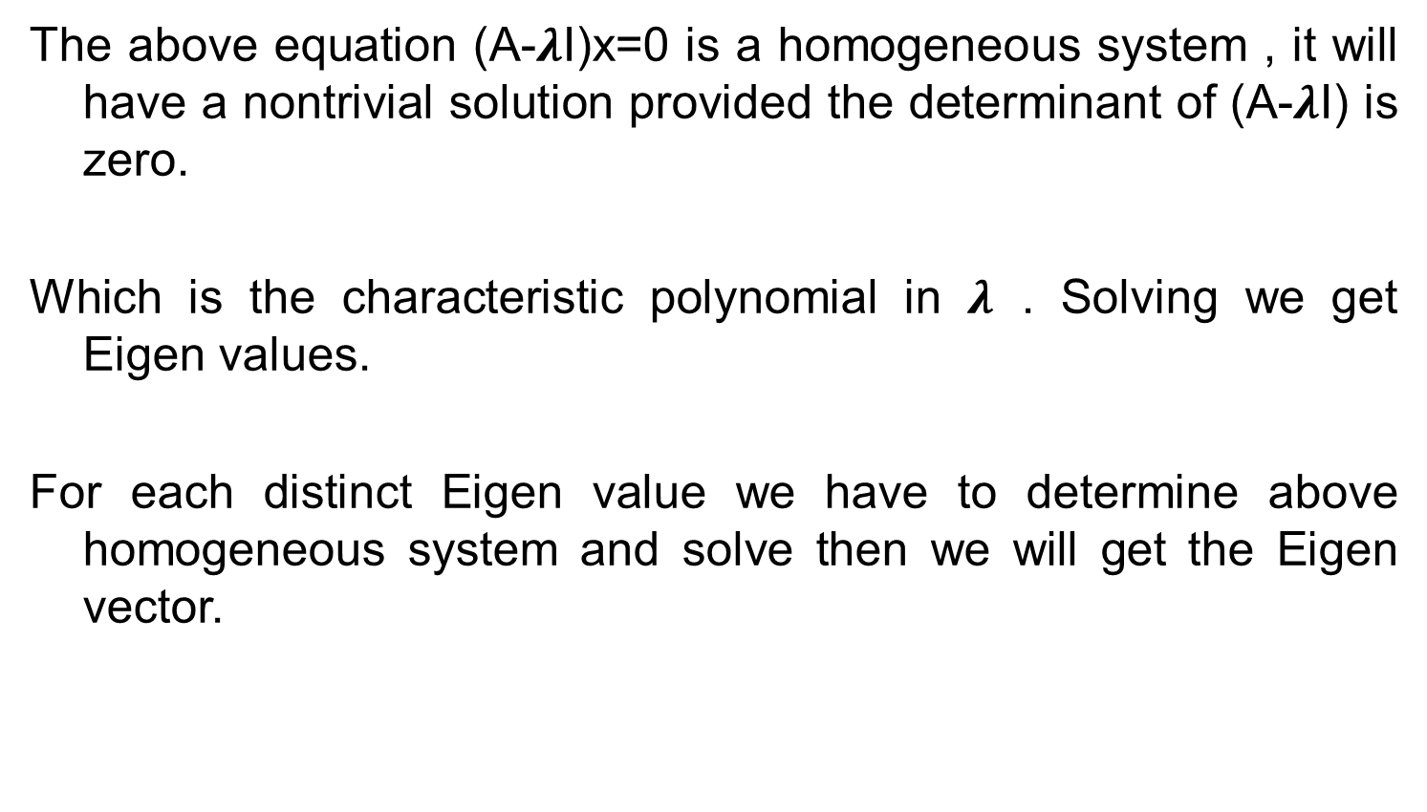
Eigen Values
The above equation (A-$λ$I)x=0 is a homogeneous system , it will have a nontrivial solution provided the determinant of (A-$λ$I) is zero.
Which is the characteristic polynomial in $λ$ . Solving we get Eigen values.
For each distinct Eigen value we have to determine above homogeneous system and solve then we will get the Eigen vector.

Slide 11
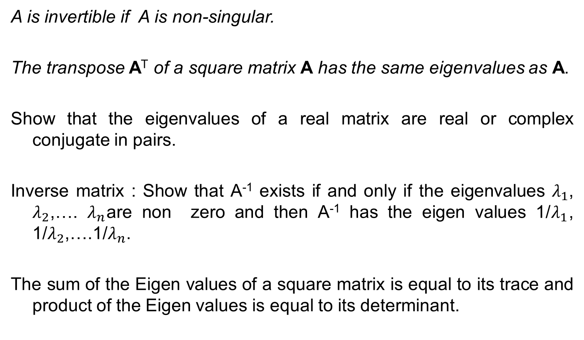
Theorems
A is invertible if A is non-singular.
The transpose A^{T} of a square matrix A has the same eigenvalues as A.
Show that the eigenvalues of a real matrix are real or complex conjugate in pairs.
Inverse matrix : Show that A⁻¹ exists if and only if the eigenvalues $λ_{1}$, $λ_{2}$,…. $λ_{n}$are non zero and then A⁻¹ has the eigen values 1/$λ_{1}$, 1/$λ_{2}$,….1/$λ_{n}$.
The sum of the Eigen values of a square matrix is equal to its trace and product of the Eigen values is equal to its determinant.

Slide 12

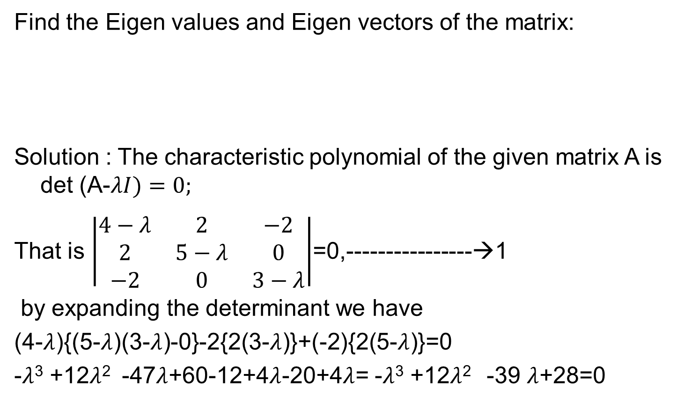
Example
Find the Eigen values and Eigen vectors of the matrix:
Solution : The characteristic polynomial of the given matrix A is det (A-$λI)=0;$
That is $\left|\begin{matrix}4−λ & 2 & −2 \\ 2 & 5−λ & 0 \\ −2 & 0 & 3−λ\end{matrix}\right|$=0,----------------→1
by expanding the determinant we have
(4-$λ$){(5-$λ$)(3-$λ$)-0}-2{2(3-$λ$)}+(-2){2(5-$λ$)}=0
-$λ$³ +12$λ$² -47$λ$+60-12+4$λ$-20+4$λ$= -$λ$³ +12$λ$² -39 $λ$+28=0
$$\left(\begin{matrix}4 & 2 & −2 \\ 2 & 5 & 0 \\ −2 & 0 & 3\end{matrix}\right)$$

Slide 13
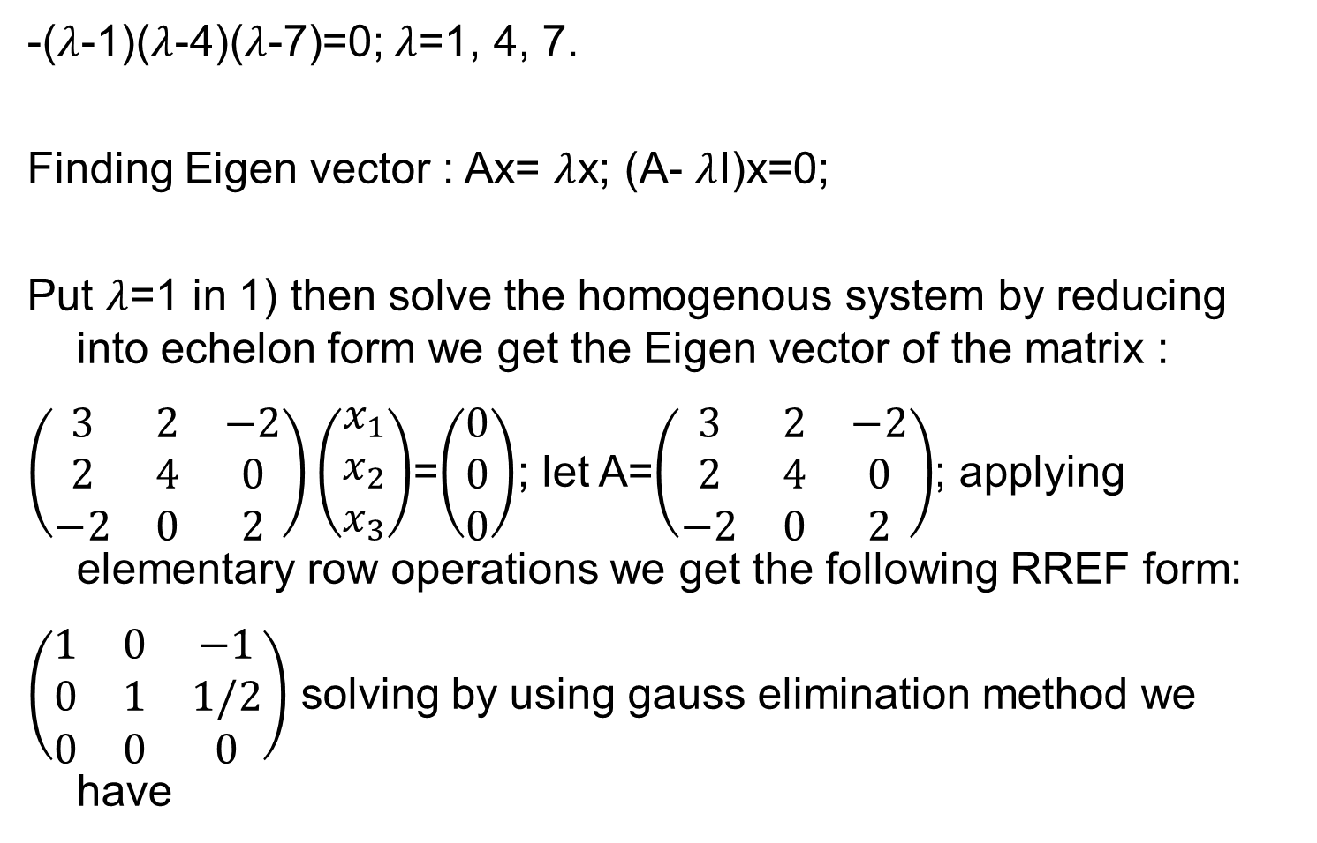
Sol.
-($λ$-1)($λ$-4)($λ$-7)=0; $λ$=1, 4, 7.
Finding Eigen vector : Ax= $λ$x; (A- $λ$I)x=0;
Put $λ$=1 in 1) then solve the homogenous system by reducing into echelon form we get the Eigen vector of the matrix :
$\left(\begin{matrix}3 & 2 & −2 \\ 2 & 4 & 0 \\ −2 & 0 & 2\end{matrix}\right)\left(\begin{matrix}x_{1} \\ x_{2} \\ x_{3}\end{matrix}\right)$=$\left(\begin{matrix}0 \\ 0 \\ 0\end{matrix}\right)$; let A=$\left(\begin{matrix}3 & 2 & −2 \\ 2 & 4 & 0 \\ −2 & 0 & 2\end{matrix}\right)$; applying elementary row operations we get the following RREF form:
$\left(\begin{matrix}1 & 0 & −1 \\ 0 & 1 & 1/2 \\ 0 & 0 & 0\end{matrix}\right)$ solving by using gauss elimination method we have

Slide 14
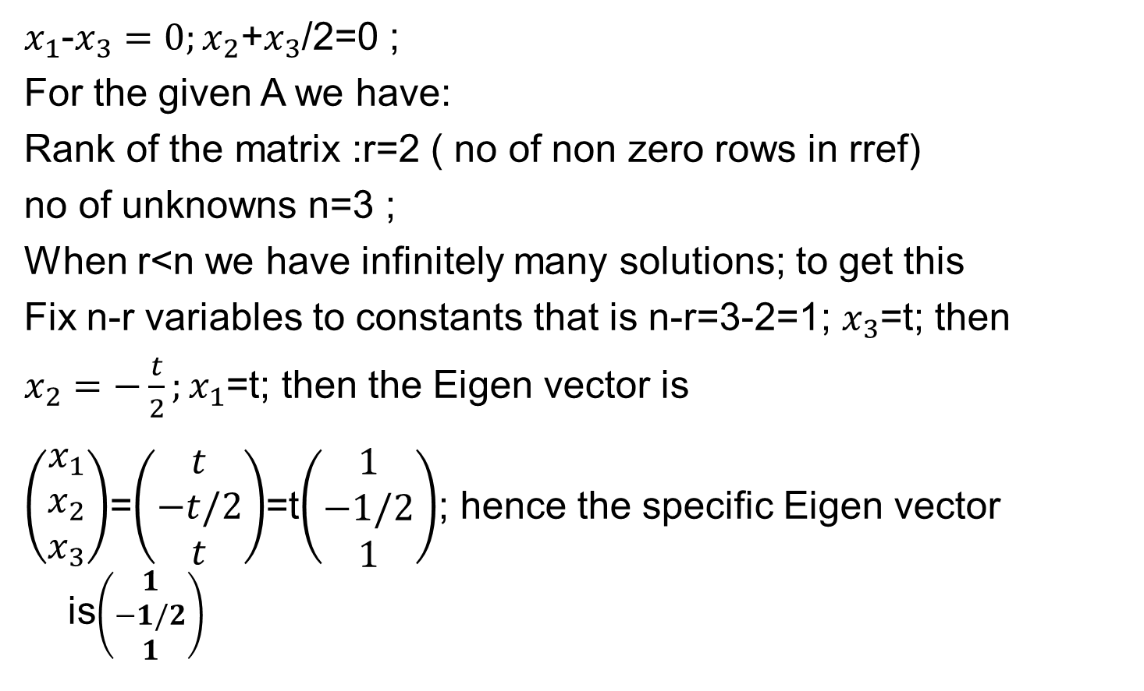
Sol.
$x_{1}$-$x_{3}=0;x_{2}$+$x_{3}$/2=0 ;
For the given A we have:
Rank of the matrix :r=2 ( no of non zero rows in rref)
no of unknowns n=3 ;
When r<n we have infinitely many solutions; to get this
Fix n-r variables to constants that is n-r=3-2=1; $x_{3}$=t; then
$x_{2}=−\frac{t}{2};x_{1}$=t; then the Eigen vector is
$\left(\begin{matrix}x_{1} \\ x_{2} \\ x_{3}\end{matrix}\right)$=$\left(\begin{matrix}t \\ −t/2 \\ t\end{matrix}\right)$=t$\left(\begin{matrix}1 \\ −1/2 \\ 1\end{matrix}\right)$; hence the specific Eigen vector is$\left(\begin{matrix}1 \\ −1/2 \\ 1\end{matrix}\right)$

Slide 15
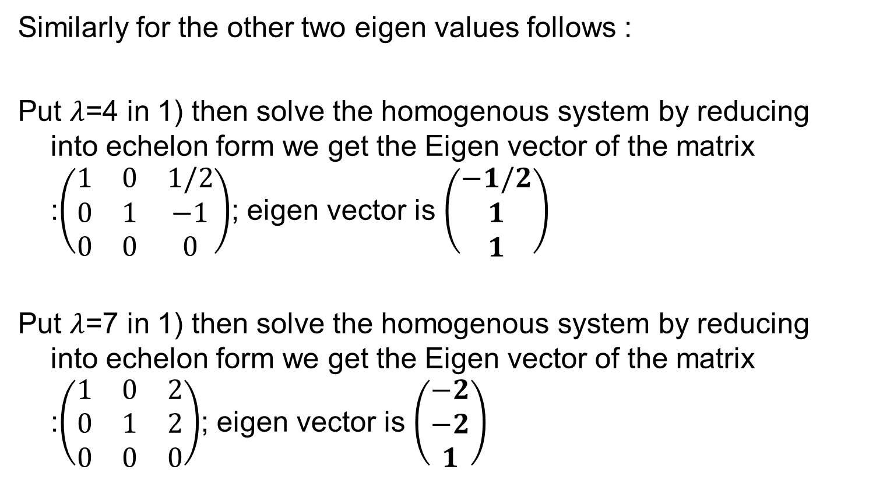
Sol.
Similarly for the other two eigen values follows :
Put $λ$=4 in 1) then solve the homogenous system by reducing into echelon form we get the Eigen vector of the matrix :$\left(\begin{matrix}1 & 0 & 1/2 \\ 0 & 1 & −1 \\ 0 & 0 & 0\end{matrix}\right)$; eigen vector is $\left(\begin{matrix}−1/2 \\ 1 \\ 1\end{matrix}\right)$
Put $λ$=7 in 1) then solve the homogenous system by reducing into echelon form we get the Eigen vector of the matrix :$\left(\begin{matrix}1 & 0 & 2 \\ 0 & 1 & 2 \\ 0 & 0 & 0\end{matrix}\right)$; eigen vector is $\left(\begin{matrix}−2 \\ −2 \\ 1\end{matrix}\right)$

Slide 16
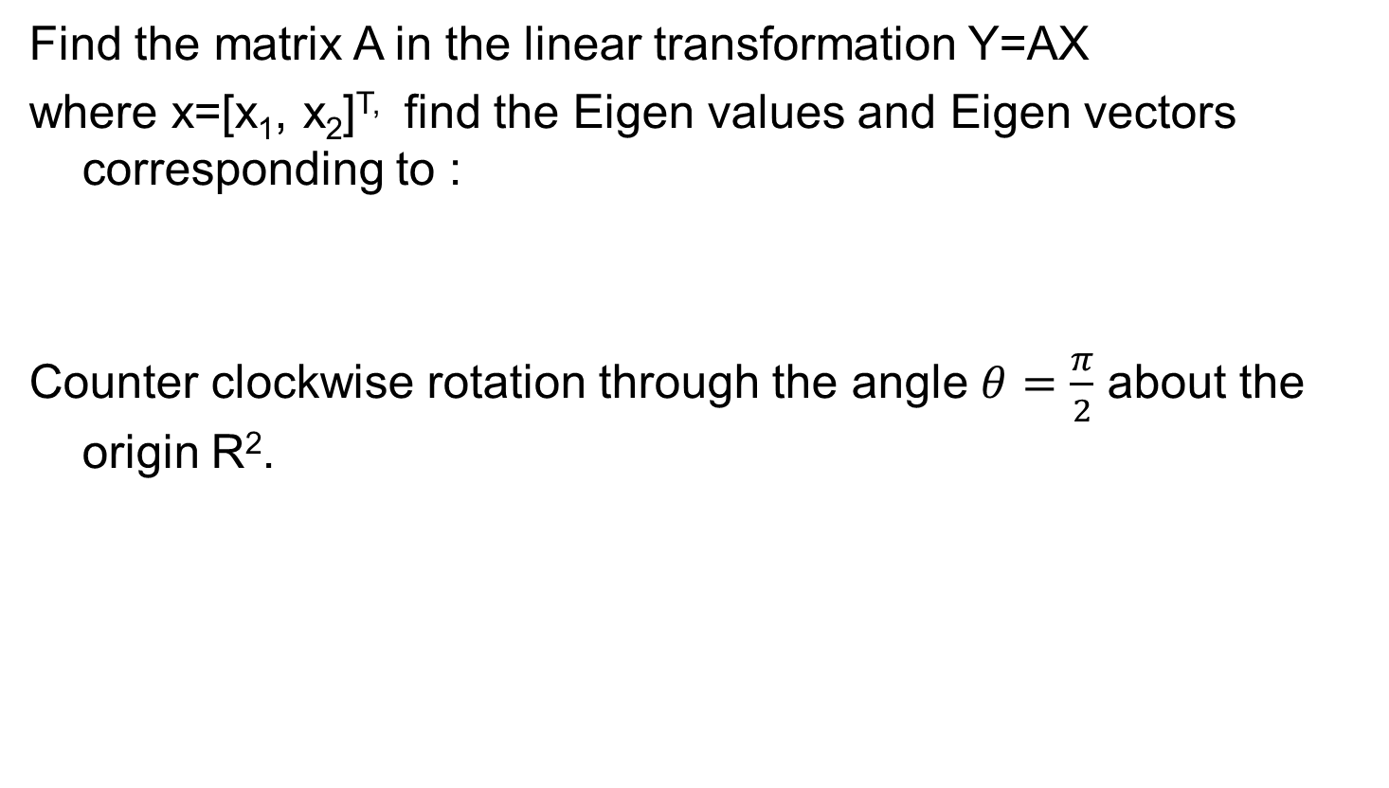
Example 2
Find the matrix A in the linear transformation Y=AX
where x=[x₁, x₂]^{T,} find the Eigen values and Eigen vectors corresponding to :
Counter clockwise rotation through the angle $θ=\frac{π}{2}$ about the origin R².

Slide 17

Example 3
Find the Eigen values and Eigen vectors of the matrix:
$$\left(\begin{matrix}−1 & 0 & 12 \\ 0 & −1 & 0 \\ \begin{aligned}0 \\ 0\end{aligned} & \begin{aligned}0 \\ 0\end{aligned} & \begin{aligned}−1 \\ −4\end{aligned}\end{matrix} \begin{matrix}0 \\ 12 \\ \begin{aligned}−4 \\ −1\end{aligned}\end{matrix}\right)$$

Slide 18
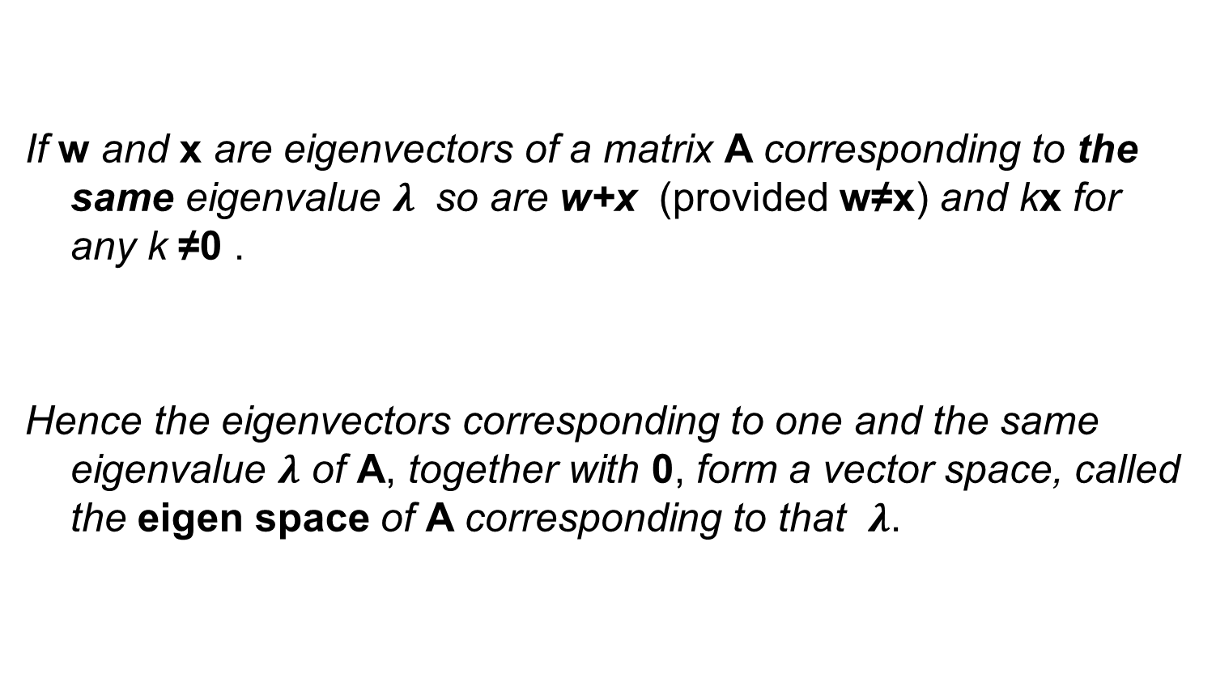
Eigenvectors, Eigen space
If w and x are eigenvectors of a matrix A corresponding to the same eigenvalue $λ$ so are w+x (provided w≠x) and kx for any k ≠0 .
Hence the eigenvectors corresponding to one and the same eigenvalue $λ$ of A, together with 0, form a vector space, called the eigen space of A corresponding to that $λ$.

Slide 19
Next Lecture
Numerical solutions to the system of equations….

Slide 20
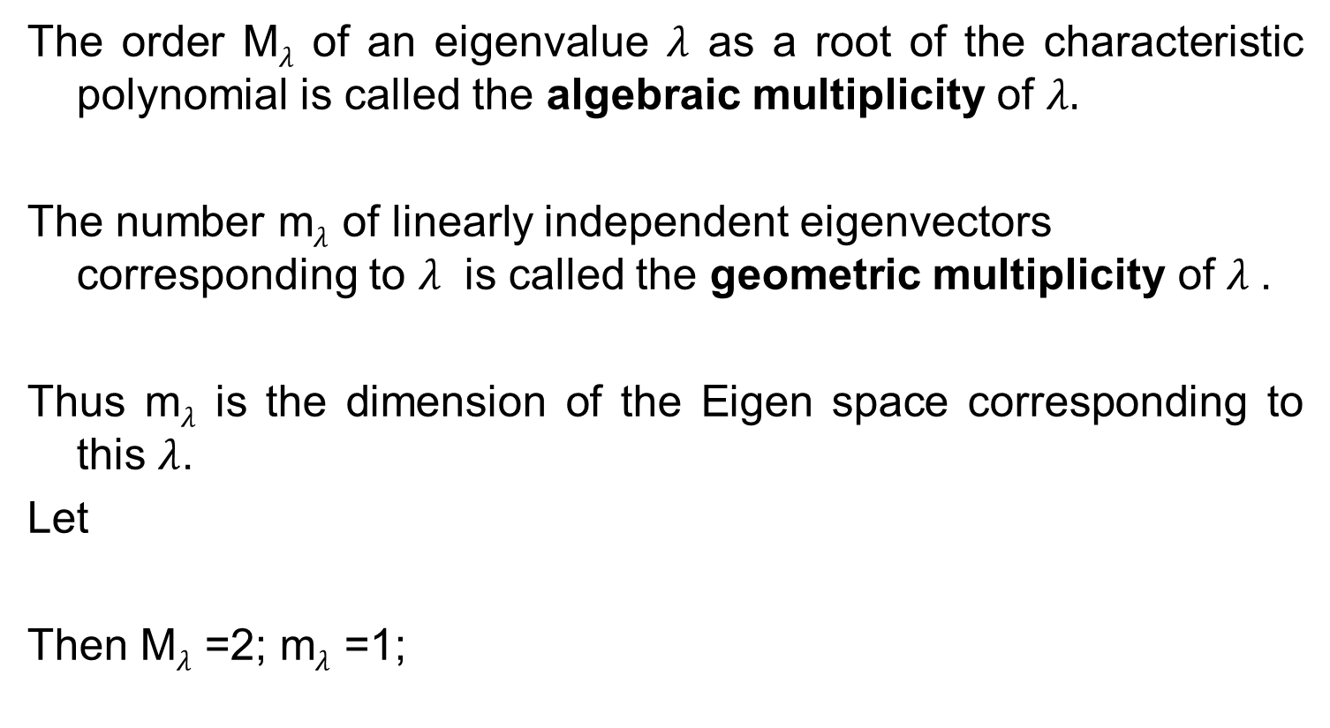
Algebraic multiplicity
Geometric multiplicity
The order M$λ$ of an eigenvalue $λ$ as a root of the characteristic polynomial is called the algebraic multiplicity of $λ.$
The number m$λ$ of linearly independent eigenvectors corresponding to $λ$ is called the geometric multiplicity of $λ$.
Thus m$λ$ is the dimension of the Eigen space corresponding to this $λ$.
Let
Then M$λ$ =2; m$λ$ =1;

